Slide 1


Join the conversation using #PPPforum
Wireless password: 12345abcde

Slide 2
Welcome
speaker:
Andrew Pinder CBE, Chairman, PhonepayPlus

Slide 3
PhonepayPlus
regulatory developments
speaker:
Jo Prowse, Acting Chief Executive, PhonepayPlus

Slide 4
What I’ll be covering:
Changes – changing market, changing PhonepayPlus
Judicial Review
A new Code of Practice & Special Conditions

Slide 5
Commitment to you on how we regulate:
Protecting consumers
Proportionate and fair
Flexible approach
Working collaboratively

Slide 6

A changing market,
A changing Code of Practice,
A changing PhonepayPlus.

Slide 7

The Judicial Review
brought by Ordanduu & Optimus

Slide 8
Emergency procedure
Communication
Costs
Implications

Slide 9

Our response to the judgment:
1. Immediate amendments to the 12th Code of Practice,
see more at bit.ly/changesto12thcode
2. A review of our legal procedures

Slide 10

Part 4 Review
Review procedures of Part 4
Compliance with EU & domestic law
Impact of any recommendations
Full consultation & approval of the 14th Code of Practice

Slide 11
Changes in communication
Blog
Emails
New
website
Forums &
Meetups

Slide 12
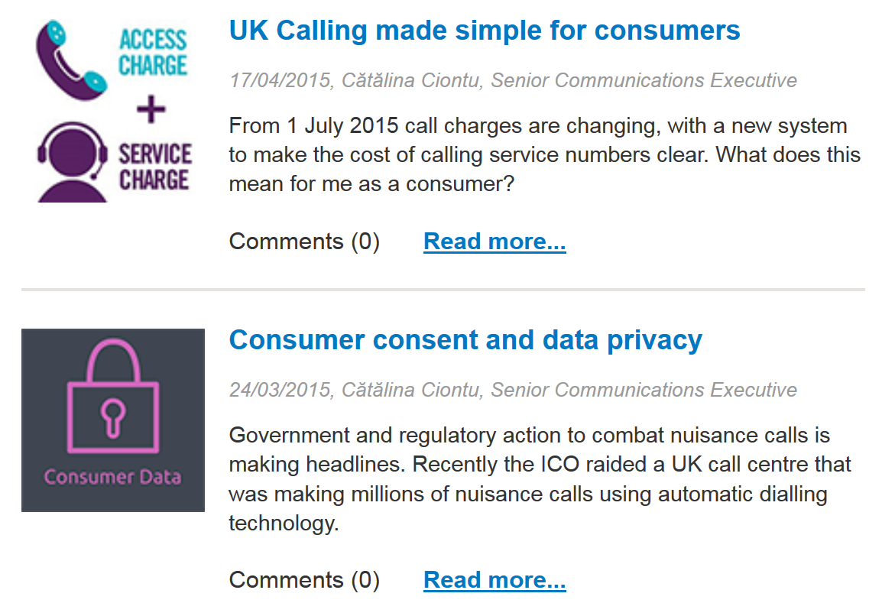
Blog

Slide 13

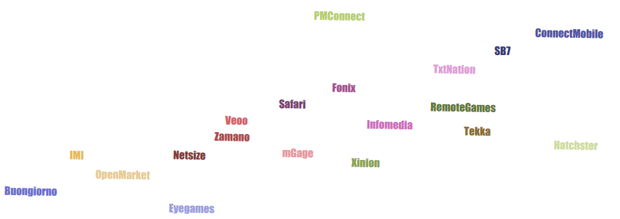
Regular meetings with industry providers
Tekka
Buongiorno
Veoo
Eye
Zamano
mGage
Veoo
IMI
Netsize
SE7
Remote Games
Safari
Xinion
Fonix
Infomedia
PM Connect
TxtNation
Connect Mobile
Open Market
Hatchster

Slide 14
Proportional approach in investigations
Over 70% of investigations resolved informally

Slide 15
Proportional approach (continued)
54%
54% less fines invoiced
vs previous years

Slide 16

11%
34%
Formal investigations
Informal resolutions
Directing 11 % less to
formal investigations and
Code Compliance Panel
Directing 34% more to
informal resolutions

Slide 17

Efforts in cost effectiveness
Partners
Overhead costs
Legal costs
Other regulators

Slide 18
25%
Reduced budget
Consumer complaints
25% budget reduction
over the past 5 years
In 2014/15 complaints up 44% on previous year

Slide 19


We need your help

Slide 20
The 13th Code of Practice is coming,
are you ready?
Vulnerable consumers
Caps
Access to customer services
Qualifications / Licenses
Special conditions

Slide 21
Get involved
Sign ups available for the following
workshops & seminars:
27th May 2015 DDRAC
24th June 2015 Special conditions
15th July 2015 Consumer vulnerability, complaint handling requirements & refund sanctions

Slide 22
Q & A Session
with
Andrew Pinder CBE, Chairman, PhonepayPlus
Jo Prowse, Acting Chief Executive, PhonepayPlus
Simon Towler, Director of Policy & External Relations, PhonepayPlus

Slide 23
Panel discussion: Developments in consumer protection in digital markets
speakers:
Chair: Kevin Brown, PhonepayPlus Board
Lynn Parker, Director, Consumer Protection, Ofcom
Mark Falcon, Head of Regulatory Policy & Strategy, Payment Systems Regulator
Simon Towler, Director of Policy & External Relations, PhonepayPlus

Slide 24
Panel discussion:
Annual Market Review & industry developments
speakers:
Chair: Hugh Griffiths, PhonepayPlus Board
Nick Lane, Chief Insight Analyst, mobilesquared
Rory Maguire, Managing Director, AIME
Dave Stephens, Senior Manager, B2B Enablers, Vodafone

Slide 25


PRS Annual Market Review 2014,
PRS market outlook 2015
By Nick Lane, chief insight analyst
@mobilesquared

Slide 26
Coming up
PRS market overview 2014-2015
The new 3 G’s
PRS users + the impact of non-compliance
4. PRS riding the technological change
5. Opportunities
mobilesquared.co.uk
@mobilesquared

Slide 27
About mobilesquared
We provide intelligence and insight on the telco and media sectors.
The real value we deliver lies in how we transform our research into high-performing content and strategy that puts our clients ahead of their competition.
Our work has a clear impact on our clients' business results, because we design each brief around their business objectives.
We've been analysing the telco space for two decades, so our experience has been earned, not learned.
Our instinctive ability to ask the right questions uncovers invaluable nuggets of insight, which we interpret to help shape truly-effective strategy for our clients.
mobilesquared.co.uk
@mobilesquared

Slide 28




















Who we work with
@mobilesquared
www.mobilesquared.co.uk

Slide 29
Our approach
Pre-research
Worked closely with PhonepayPlus and the PRS industry to identify key areas to research
The research
  Quantitative consumer survey
  Street research
  Industry research
Post-research
Worked with PRS industry to sense-check research findings (March-April 2015)
mobilesquared.co.uk
@mobilesquared

Slide 30
Methodology
2014 revenue market-modelling
The market-modelling exercise was based on revenue (excluding VAT) from the network returns submitted to PhonepayPlus, combined this with consumer survey data about stated use of different services by consumers.
The subsequent model produced estimates of revenue for different categories of service. These figures were then sense-checked with the PRS industry, and adjustments were made to account for over- or under-reported use of services.
Charitable donations were introduced to the model on the basis of a robust figure derived from figures supplied by industry players working in that sector and consumer data. This is a departure from the methodology in previous years, in which estimates of charitable donations by premium rate were calculated as a percentage of the rest of the market.
2015 forecasting
Methodology employed in the sector-by-sector forecasting for 2015 was based on the 2014 market modelling exercise. Forecast annual revenues for each payment platform were derived by taking the annual totals from 2010-2014 and extrapolating to 2015 using least-squares regression.
Adjustments were then made to account for over- or under-reported use of services. Sense-checking with the PRS industry was applied according to industry forecasts for their sectors.
Nb. The forecasts are based on data and information collated during the research process.
mobilesquared.co.uk
@mobilesquared

Slide 31
Methodology
Consumer survey
The quantitative consumer survey went out to a nationally representative online sample of 8,538 participants aged 11 and above in order to provide a representative sample of 3,000 users of premium-rate services. Questions in relation to adult entertainment, dating and gambling did not go out to under-18’s.
The online survey was conducted by Lightspeed GMI between December 2014 - January 2015
The consumer raw data provided by the consumer research was then sense-checked by 116 face-to-face consumer interviews, conducted in March in Guildford, Peterborough and Reading.
Industry research
Mobilesquared conducted 122 interviews, spanning 95 companies, operating within and outside of the PRS sector. The interviews took place between December 2014 and March 2015.
mobilesquared.co.uk
@mobilesquared

Slide 32
Market in decline
£686.6 mil.
(excl VAT)
Revenues down 3.2% on 2013
£571.6 mil.
(excl charitable donations, excl VAT)
Fourth successive year PRS market revenues have dropped
PRS market contracted by 16% since 2010
*Revenues include charitable donations
mobilesquared.co.uk
@mobilesquared

Slide 33
Revenues by service type
Directory enquiries still on top
Consumers drawn to simplicity of charitable donations
mobilesquared.co.uk
@mobilesquared

Slide 34
Revenues by payment type
“Mobile” + “Operator billing” accounted for 60% of total revenue in 2014
17%
Mobile + Operator billing revenues 2014
£411.89 mil. (excl VAT)
Voice-based* revenues 2014
£274.72 mil. (excl VAT)
*including red button
13%
10%
50%
% of total revenues
mobilesquared.co.uk
@mobilesquared

Slide 35
Revenue change by payment platform
DQ, 087, voice PRS/09* hardest hit by decline in market revenues.
*incl. Red button
£m excl VAT | 2013 | 2014
Directory enquiries (DQ) | 140.93 | 116.93
Mobile (including voice shortcodes) | 328.35 | 343.45
Operator billing (incl PayforIt) | 36.82 | 68.44
Voice PRS/09 & red button | 119.2 | 88.65
Voice 087 | 83.63 | 69.14
Total | 708.9 | 686.60
mobilesquared.co.uk
@mobilesquared

Slide 36
Forecast 2015e
£637.5 mil.
(excl VAT)
Revenues down 7.2% on 2014
£513.5 mil.
(excl charitable donations, excl VAT)
*Revenues include charitable donations
mobilesquared.co.uk
@mobilesquared

Slide 37
2015e forecasts by service type
The new 3 G’s
Giving, Gaming, Gambling
Only 3 services to experience growth 2014-to-2015
The 3 G’s
2014: £229.9 mil (excl VAT) / 33% of total revenues
2015: £250.4 mil (excl VAT) / 39% of total revenues
mobilesquared.co.uk
@mobilesquared

Slide 38
Forecasts 2015e by payment type
“Mobile” + “Operator billing” projected to account for 66% of total revenue in 2015
10%
15%
10%
Mobile + Operator billing revenues 2015
£419.3 (excl VAT)
Voice-based* revenues 2015
£218.2 (excl VAT)
*including red button
12%
53%
% of total revenues
mobilesquared.co.uk
@mobilesquared

Slide 39
2014-15e revenues
2015e
Revenue decline accelerating for DQ &
voice PRS/O9 services
2015e
Mobile + Operator billing revenues forecast to grow 2%
Voice-based services forecast to fall 21%
mobilesquared.co.uk
@mobilesquared

Slide 40
% change
mobilesquared.co.uk
@mobilesquared

Slide 41
PRS users
PRS users, as of Jan 2014:
19.3 mil.
Average PRS users per service, Jan 2014:
3.1 mil.
Average
Nb. Users by PRS service have been calculated using the weightings for over/understated use applied to the PhonepayPlus market model.
mobilesquared.co.uk
@mobilesquared

Slide 42
State of play 2014-15e
Games & apps
20%
Gambling
Charity donations
10%
Games on social networks
0%
Users, Jan 2014
1,000,000 2,000,000 3,000,000 4,000,000 5,000,000 6,000,000 7,000,000 8,000,000 9,000,000
Virtual gifts
Ringtones, RBTs, wallpaper
Music / video content
Internet-based info services
Music / video content
% revenue growth, 2014-15
087 customer service
Dating or flirt services
Competitions or quizzes
-10%
Off-handset purchase (adult)
Adult
TV / radio interaction
Low cost int’l / reverse calling
Directory enquiries
Tarot or astrology
-20%
Off-handset purchase (adult)
Low risk to service – Annual decline in revenues less than 10%, lower-than-average to average user base
Medium risk to service – Annual decline in revenues of up to 15% with lower-than-average user base
– Annual decline in revenues greater than 15% with higher-than-average user base
High risk to service – Annual decline in revenues greater than 15%, lower-than-average user base
Voice-based info services
Tarot or astrology
Adult
-30%
High risk to service
Medium risk to service
Low risk to service
mobilesquared.co.uk
@mobilesquared
-40%

Slide 43
PRS ARPU (annualised)
2014
£35.60
(Incl. charitable donations, excl VAT)
2015e
£38.64
(Incl. charitable donations, excl VAT)
PRS market losing low-paying users
Consumers say*:
Consumers believe PRS costs between £0.25 - £10*
Cost to vote Cost to call
on X Factor DQ (p/min)
Average response £1.63 £1.08
* Source: Street research, mobilesquared March 2015
mobilesquared.co.uk
@mobilesquared

Slide 44
Users 2014-15e
Consumer reasons for stopping PRS usage during 2014, include:
- Stopped trusting PRS
- Problems with a service
- Free content elsewhere
- Using other paid services
- No longer see value in PRS
Services not as good as they were
Not interested in the service any more
- I pay for the services using credit/debit card
19.3 mil.
16.5 mil.
PRS industry lost 233,000 users per month in 2014
Non-compliance activity accounted for 108,000 (or 46%) of these users per month
125,000 people per month stopped using PRS because of cost, service relevance and alternative content-related issues
mobilesquared.co.uk
@mobilesquared

Slide 45








PRS weathered device evolution
16.5 mil.
users
PRS
2015
2000
2002
2005
2006
2007
2015
WAP
Launched in UK
N series
launched
Mobile internet comes of age
App Store
launched
mobilesquared.co.uk
@mobilesquared

Slide 46
Smartphone impact
Smartphone penetration 68%
Smartphone penetration among PRS users: 72%
Why have you reduced or stopped using PRS in 2014?
2.8 million PRS users claim they get free content elsewhere
2.6 million people claim to not afford PRS any more
Source: mobilesquared research
mobilesquared.co.uk
@mobilesquared

Slide 47
Payment opportunity
Smartphones creating new mobile payment opportunity – PRS expansion into quasi-physical and physical goods.
Operator billing only PRS area experiencing growth; projected to slow down in 2015.
Industry waiting for release of the update to Payment Service Directive (PSDII) in July 2015 before deciding mobile payment strategy;
  Major Level 1 providers expected to reduce role in PRS sector in pursuit of mobile payment strategy.
Operator billing to be viewed as separate platform from traditional PRS services in order to attract corporations and major retailers (brand identity);
  Brand reputation an important consideration
PayforIt potentially becoming “brand” for operator billing restricted to PRS sector.
Credit/debit cards have the march on operator billing;
  Industry outpayment timelines a potential hurdle.
Operator billing requires significant promotion from a united industry.
10.8 million PRS users would be interested in using their mobile phone to pay for “other” transactions
that appear on their monthly mobile phone bill, or uses available credit from their pay-as-you-go account
Opportunities for Operator billing
Toll roads
Vending machines
Take-aways
Ticketing
Electric car charging
Hiring of rental bikes (e.g. Boris Bikes)
Airtime credit payments (e.g. Father-to-child)
mobilesquared.co.uk
@mobilesquared

Slide 48
Working in unison
Industry and PhonepayPlus worked successfully together to counter threat from non-compliant affiliate marketing (initiative commenced mid-2013).
Increased openness and closer working relationship between industry and regulator developed during 2014.
Formation of rapid response unit viewed as significant step forward.
Disconnect between industry and regulator remains.
mobilesquared.co.uk
@mobilesquared

Slide 49
Key findings
1. PRS market decline continues: Down 3.2% 2013-2014, projected to fall 7.2% 2014-2015.
2. Operator billing only payment mechanism within PRS experiencing revenue growth; promise of quasi-physical and physical goods revenues prompting major Level 1 providers to develop divergent strategy.
3. Service growth from the 3 G’s of Giving, Gaming, and Gambling.
4. PRS users dropped from 19.3 million (Jan 2014) to 16.5 million (Jan 2015); ARPU increasing
5. Non-compliance accounts for the loss of 46% of users per month; cost, service relevant and alternative content-related issues affect the remaining 54%.
6. Compliance hit 80% in 2014, industry targeting 85-90% in 2015.
7. Disconnect between industry and regulator remains.
nick@mobilesquared.co.uk
@mobilesquared

Slide 50
Concluding remarks
speaker:
Andrew Pinder CBE, Chairman, PhonepayPlus

